Slide 1
Youth Positive Youth Development
YPYD Toolkit

Slide 2
Introduction to PYD 101
PYD 101
  Positive Youth Development 101 was developed by Jutta Dotterweich, Cornell University, in collaboration with:
    New York State (NYS) 4-H State Office
    NYS 4-H Educator Association
    Risk and Thriving in Adolescence Program Work Team
    NYS Advancing Youth Development Partnership
Notes:
Positive Youth Development 101 is a training for youth workers. We consider any professional or paraprofessional who works directly with young people a youth worker.
The goal of PYD 101 is to make youth workers familiar with positive youth development as an approach or philosophy of working with young people. The training explores its core concepts and underlying theoretical frameworks, the research that supports it, and its practical application. It also provides youth development works with resources to enhance their work with youth.

Slide 3
Introduction to YPYD
Youth Positive Youth Development (YPYD)
Adapted from the PYD 101 Curriculum with collaboration from
  Kansas Enrichment Network
  Kauffman Foundation
  Youth from the KCK Saturday Academy
Notes:
The goal of YPYD is to introduce youth to theories and practices in the field of youth development. This curriculum has been adapted from the Positive Youth Development 101 curriculum designed by Jutta Dotterweich from the ACT for Youth Center of Excellence of Cornell University (and other development partners). It was adapted with the help from youth who attended the KCK Summer Academy in the spring of 2018 and staff from the Kansas Enrichment Network.

Slide 4
What comes to mind?
Notes:
What comes to mind when you think of positive youth development? Break up into small groups. Within those groups, discuss what you think PYD is and come up with 1 word that you can use to describe it. This word cannot be “positive”, “youth”, or “development”.(5 minutes)
Have the audience report out on what word they came up with. A facilitator should write each groups’ word down on a flip chart paper that is located towards the front of the room (or an area that can be referred to during the training.)

Slide 5
Roadmap
The training will be covering these topics:
  What is PYD?
  Positive Youth Outcomes
  Youth Engagement
  Youth Brain Development
  Youth Diversity
  Strengths and Sparks
  Telling Your Story
Notes:
Here is a roadmap of what this training entails. Each of these areas will be expanded upon throughout the training. Breaks will be given throughout the training.
**The facilitator should share with the audience the location of bathroom, snacks, drinks, and any other logistical information they feel is important. They should also make note that this space will be an open and safe environment and the audience is allowed (and encouraged) to bring up questions to further lead the discussion on these topics. Audience participation is very important!**

Slide 6
What is Positive Youth Development?
Positive youth development is…
  An approach or philosophy that guides communities in the way they organize services, supports, and opportunities so that all young people can develop their full potential.
    A focus on strength and positive outcomes.
    Youth voice and engagement.
    Strategies that involve ALL youth
    Community involvement and collaboration.
    A long term commitment.
http://actforyouth.net/youth_development/development/
Notes:
Positive youth development is a framework that guides communities in the way they organize services, opportunities, and supports so that young people can develop to their full potential. Positive youth development is not just another program. Communities that adopt a youth development approach emphasize these principles:
Focus on strengths and positive outcomes. Rather than taking a deficit-based approach, communities intentionally help young people build on their strengths and develop the competencies, values, and connections they need for life and work.
Youth voice and engagement. Youth are valued partners who have meaningful, decision-making roles in programs and communities.
Strategies that involve all youth. Communities support and engage all youth rather than focusing solely on "high-risk" or "gifted" youth. Communities do, however, recognize the need to identify and respond to specific problems faced by some youth (such as violence or premature parenthood).
Community involvement and collaboration. Positive youth development includes but reaches beyond programs; it promotes organizational change and collaboration for community change. All sectors have a role to play in making the community a great place to grow up.
Long-term commitment. Communities provide the ongoing, developmentally appropriate support young people need over the first 20 years of their lives.

Slide 7
What is Positive Youth Development?
Activity – Mingle, mingle, huddle, huddle
Notes:
Have the audience members partner up and discuss these 3 questions (5 minutes):
What are/were some high points that you’ve experienced during school?
What are/were some low points?
What/who helped you get through them?
Reflect on this activity. Have the audience members share their high/low points if they are comfortable. As a facilitator, sharing your own experiences might spark audience participation (if you are comfortable sharing). Make sure to note any common occurrences or “ah-ha’s”.

Slide 8
Ecological Model of Development
Bronfenbrenner’s Ecological Model of Development
  Individual
  Microsystem
  Mesosystem
  Exosystem
  Macrosystem
  Chronosystem*
Notes:
Bronfenbrenner’s Ecological Model of Development is the “identification of 6 environment systems with which an individual interacts.”
These 6 systems are:
Individual
Age, sex, health, etc.
Microsystem – these systems most directly impact the child
Family, peers, school, religious institutions
Mesosystem – connections between the microsystems
Interactions between family and teachers, between a person’s peers and family
Exosystem – connections in social settings in which the individual does not have an active role
Parent’s workplace, community services, mass media
Macrosystem – the culture in which a person lives
Culture, society, socioeconomic status, ethnicity, laws
Chronosystem – environmental events and transitions over a lifetime
Time

Slide 9
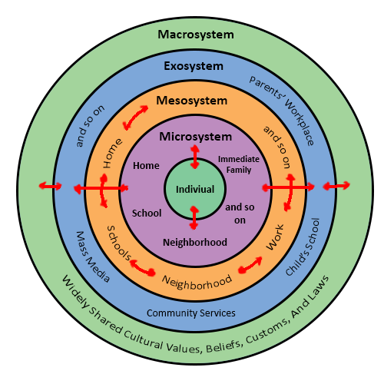
Ecological Model of Development
http://psych2015.weebly.com/psych-journal/journal-8-urie-bronfenbrenners-ecological-systems-theory
Notes:
Here is a visual that shows the different layers of the Ecological model.
Stop and reflect on the Ecological model. Any thoughts/comments come to mind?

Slide 10
Maslow’s Hierarchy of Needs
Maslow’s Hierarchy of Needs
  Physiological needs
  Safety needs
  Belongingness and love
  Esteem
  Self-actualization
Notes:
Maslow’s Hierarchy of Needs is a “motivational theory in psychology comprising a five-tier model of human needs, often depicted as hierarchal levels within a pyramid. Needs lower down in the hierarchy must be satisfied before individuals can attend to needs higher up.
The 5 tiers are:
Physiological needs:
Food, water, warmth, rest
Safety needs:
Security, safety
Belongingness and love needs:
Intimate relationships, friends
Esteem needs:
Prestige and feeling of accomplishment
Self-actualization
Achieving one’s full potential including creative activities

Slide 11
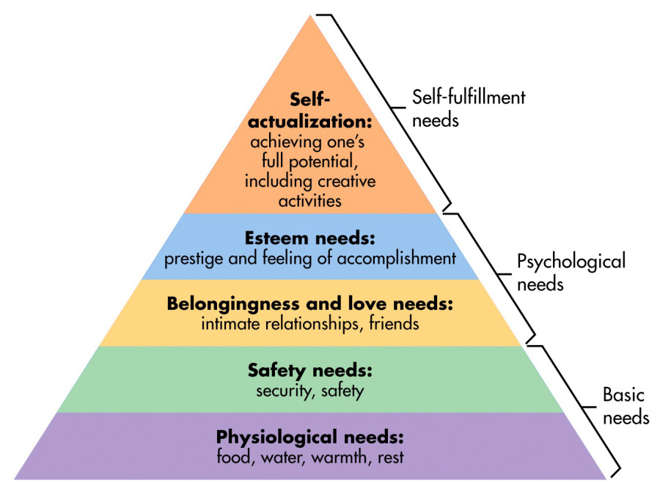
Maslow’s Hierarchy of Needs
https://www.simplypsychology.org/maslow.html
Notes:
Here is a visual of Maslow’s Hierarchy of Needs. Remember that needs lower down in the hierarchy must be satisfied before individuals can attend to needs higher up.
Stop and reflect on the hierarchy. Any thoughts/comments come to mind?

Slide 12
Social toxicity
What is social toxicity?
Notes:
Begin by explain what social toxicity is – “the extent to which the social environment operates is poisonous, in a sense that it comes serious threats to the development of identity, competence, moral reasoning, trust, hop and other features of personality and ideology that make for success in school, family, work, and the community. (https://helpingfamilieschange.org/garbarino-takes-on-social-toxicity/)
Interact with the audience. Have them shout out different types of social toxicities that they’ve experienced or see others experience. Write these down on a flip chart. These could include bullying, cyberbulling, racism, sexism, gender inequality, poverty, violence, etc.

Slide 13
Social Toxicity
PYD in Action!
Notes:
PYD in Action Activity! (15 minutes)
“I would like to do a brief activity to demonstrate some of the theoretical concepts we’ve discussed. I need a volunteer who appreciates the opportunity to go back in time and be 14 again (or to represent themselves if your audience is all youth)”. Ask the volunteer for his/her name. Ask the group – quickly: “What are the challenges that young people face today, in this society?” Each participant who names a challenge will be handed a light foam ball. Stop at eight. Challenges should include: drugs, violence, early sex/teen pregnancy, school dropout/failure, depression, gangs, etc. Ask those eight participants to come forward, and line them up between 6-10 feet from the volunteer. “When I count to three and say “go,” the challenges over there will come your way.” They will throw everything they have at you. Make sure everybody understands the charge. After all of the challenges have been thrown, ask the volunteer how they felt having 0 support. Did the volunteer just stand there and get hit with the challenges or did they try and dodge/block them? This is a good way to visualize resiliency in youth!
“Next, I need a second volunteer who will be the parent/guardian.” Ask volunteer for his/her name. To the “parent”: “Here are all the challenges your teen is facing. Your charge as a parent is to protect your child. Prepare yourself to protect [youth]. When I count to three and say “go,” the challenges over there will come your way. They will throw everything they have at you.” Make sure everybody understands the charge. After they throw the balls, ask the volunteer “teen” how s/he felt about it. Did s/he feel safe? Direct attention to the parent. Did the parent just stand there or did the parent actively try to help their “child”? This discussion can lead to the role that parents play in a youth’s development – should the parent be directly in front of their child blocking everything while the child hides behind them or should the parent stand beside the student and support them on an equal ground? Gather the balls and give them back to the eight volunteers.
Ask the audience: Who else can we call on to help? What other people and organizations in the community can we call in? (Helpers can be a neighbor, teacher, religious leader, youth program leader, coach, member of the extended family, etc.). Once the audiences identifies a person/organization, ask if anybody in the group plays that role (if no one does just ask for a volunteer to represent the role). Ask them to come up. Identify and gather six or seven people. You are all supporters and protectors of [youth]. Your charge is to help the parent/guardian protect [youth]. Take a minute to come up with a plan, and then you’ll face the challenges one more time. Ask the volunteers representing challenges to line up again. On “go” they will throw their balls again. Afterwards ask [initial volunteer] how it felt this time.
Reflect on activity. This can be a very powerful activity that can lead to multiple discussions on youth resiliency, a parent’s/guardian’s role in youth development, and how organizations can support the youth / each other!

Slide 14
PYD Paradigm Shift
Traditional Youth Services
Positive Youth Development
Fixing problems
Reactive
Troubled youth
Youth as recipients
Programs
Professional work
Strengths based
Pro-active
All youth
Youth as participants/resources
Relationships
Everyone’s work
http://actforyouth.net/youth_development/development/
Notes:
PYD has changed and evolved over time. We are moving from fixing problems to building strengths. Instead of reacting to a problem behavior, we are pro-active, building positive outcomes. Instead of targeting troubled youth we engage all youth. We move from looking at youth as recipients of services to youth as resources and active participants. Traditionally we focus on programs and interventions, now we focus on relationships. Through this emphasis on the importance of relationships, young people become not just the business of professionals, but of everyone in the community.
Reflect on these lists. Thoughts/questions from audience?

Slide 15
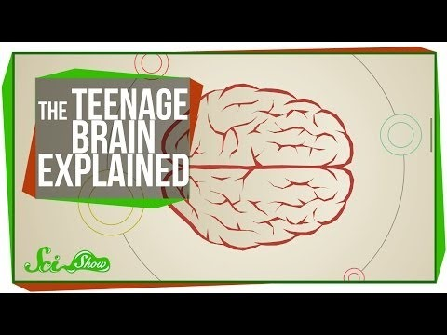
Teen Brain Development
Notes:
In recent years we have heard much about the teen brain. New advances in technology have shed light on brain functioning and development. We now realize that adolescent brains are not fully developed. The brain centers that are responsible for rational decision making and emotional regulation follow different developmental timelines.
Reflect on the video. What did you find interesting? What would you like to know more about?
Video link: https://www.youtube.com/watch?v=hiduiTq1ei8

Slide 16
Positive Youth Outcomes
Strengths-based approach
  People are active participants in the helping process (empowerment)
  All people have strengths, often untapped or unrecognized
  Strengths foster motivation for growth
  Strengths are internal and environmental
http://actforyouth.net/youth_development/development/
Notes:
We discussed earlier how PYD has evolved from “fixing problems” to a “strengths-based” approach. Strength-based came from the field of social work and is supported by resiliency research. A strength-based approach is a powerful set of ideas, assumptions, and techniques:
People are not recipients but active participants in the helping process, which is very empowering. Let’s remember Bronfenbrenner as well who stated young people are agents in their development.
All people have strengths, but often they are not used or even recognized. As all of you have probably experienced, if you ask young people what their strengths are, they don’t know what to say.
Being able to use your strengths creates motivation to grow and learn. The converse is also true: We all know that it is not very motivation to focus on your weaknesses and work on improving your weak spots.
Finally, we know from resiliency research that we have internal strengths such as abilities and talents, and external strengths such as relationships and opportunities to matter, to be responsible for something.
Identifying and nurturing strengths is a critical step in engaging young people. In recent years, Dr. Peter Benson from Search Institute coined the term “sparks,” brining concrete meaning to this concept of strengths.

Slide 17
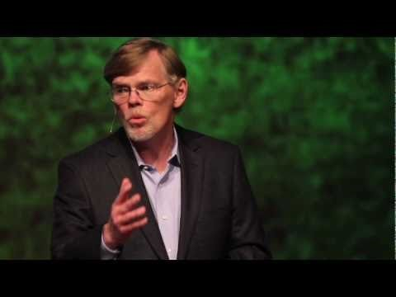
Positive Youth Outcomes
Notes:
**This video is a TED Talk by Dr. Peter Benson that is titled “Sparks: How Youth Thrive”. It is a little over 20 minutes long. This would be a great video to watch during lunch.**
Video link: https://www.youtube.com/watch?v=TqzUHcW58Us&t=2s

Slide 18
Positive Youth Outcomes
Sparks
  “A spark is something that gives your life meaning and purpose. It’s an interest, a passion, or a gift.” – Dr. Peter Benson, Search Institute
http://actforyouth.net/youth_development/development/
Notes:
Dr. Benson called a special quality, skill or interest that we are passionate about a “spark.” Sparks originate form inside a person. When we express it, we feel alive, useful. Life has a purpose.
All young people have one or more sparks. Sparks are more than just things we like to do. They’re a prime source of meaning, self-directed action, and purpose.
If the word “sparks” doesn’t work for the youth you are working with, you can talk to them about their strengths, interests, passions, or purpose.

Slide 19
Positive Youth Outcomes
Sparks Interview
Notes:
Sparks Interview Activity (15 minutes - gauge audience to shorten/lengthen time)
Have the audience partner up. The groups will then need to interview each other (and write down the other’s response) over these 7 questions
What are your sparks? What are you excited about? How did you discover your spark?
How have you worked at improving your spark? What skills have you learned from it?
Who are/were your ‘spark champions’? Who supported you along the way?
**Give the groups enough time for each person to be the interviewer and interviewee. Have groups report out about their partner’s spark (if the partner is comfortable having their spark shared with the group)**

Slide 20
The 6 C’s of PYD
What are competencies, attitudes, characters, and values that we want to see with people working in youth development?
Notes:
Small group discussion (5 minutes)
Have the tables discuss the question on the slide: “What are competencies, attitudes, characters, and values that we want to see with people working in youth development?” Have each of the tables share a summary of their discussion.

Slide 21
The 6 C’s of PYD
Competence
Confidence
Connection
Character
Caring
Contributions
Notes:
**Facilitator should have each of the 6 C’s written on their own flip chart pages and scattered around the room on the wall. The Facilitator will refer to the words throughout the room and they will be used for an activity.**
“The C’s emerged in the 1990s with contributions from many researchers and practitioners. Based on research, this framework provides us with a vocabulary to describe what young people need to succeed. The 6 C’s of PYD are competence, confidence, connection, character, caring and contributions.”

Slide 22
The 6 C’s of PYD
Competence
  The ability to act effectively in school, social situations, and at work. This includes academic, cognitive, social, emotional, and vocational competencies
Confidence
  A sense of overall self-worth and efficacy
Connection
  A sense of belonging, positive bonds with people and social institutions
Notes:
Refer to handout “Positive youth Outcomes – 6 Cs”
“Competence is the ability to act effectively in school, social situations, work, etc. Confidence is a sense of overall self-worth. Connection is a sense of belonging.”

Slide 23
The 6 C’s of PYD
Character
  Respect for society and cultural rules, an inner moral compass
Caring
  A sense of sympathy and empathy for others, a commitment to social justice
Contribution
  Active participation and leadership, giving of oneself to bring about change in social and civic life.
Notes:
“Character is respect for society and cultural rules. Caring is a sense of sympathy and empathy. Contribution refers to active social and civic participation. Each of these C’s is important in the development of young people in order to build them into successful adults.”

Slide 24
The 6 C’s of PYD
Bump it up!
Notes:
Activity: Bump It Up (25 minutes)
Split the group into 6 different (ideally equal) sized groups. Each group will brainstorm approaches and activities to build young people’s capacity in one of the 6 C areas. They will write these ideas down on a post it and put it on the corresponding flip chart. You will only have a few minutes. Next, we will “bump up” every group clock wise so that they have moved to a C that they haven’t previously visited. You will continue bumping each group until everyone has visited each C and have returned to their original C. (You can save time only have a 3 rotations instead of doing all 6.) Each group should then familiarize themselves with the post-its that each of the others groups wrote on C that they started with. Have the groups report out and discuss what was written.

Slide 25
SOS Mapping
Services, opportunities and supports
  Services
    Efforts done to or for youth in order to enhance health, safety, performance, and other forms of essential well-being and physiological functioning
  Opportunities
    Opportunities are done by young people.
  Supports
    Include processes and strategies undertaken with young people that facilitate access to interpersonal relationships and resources.
Notes:
“Thinking back to Maslow’s hierarchy of needs, this model incorporates the reality that young people might have needs that must be addressed before they can learn and thrive. It also reflects a core principle of youth development: Youth development is community-based. Young people grow up and develop in interaction with various social groups and institutions within a community, not just in programs.”
Define SOS
Services are the efforts done to or for youth in order to enhance safety, performance, other forms of essential well-being and physiological functioning (going back to Maslow’s hierarchy of needs). These are the traditional services provided by public health systems, school districts, and other providers.
Supports include processes and strategies undertaken with young people that facilitate access to interpersonal relationships and resources. Taken as a whole, supports promote a positive climate within which development occurs. Karen Pittman identified three different categories of support: Emotional support facilitates a sense of safety, nurturing, and friendship. Motivational support provides positive expectations, guidance, and developmentally appropriate boundaries. Strategic support facilitates access to needed resources and information.
In this model, opportunities are done by young people. It is within the realm of opportunities that youth become actors rather than recipients. Youth are provided meaningful and real opportunities to practice and expand on what they know and learn – either through work, service, or advanced learning. Opportunities in which youth are encouraged to exercise meaningful decision-making roles ultimately demand and foster the greatest number of competencies in young people.

Slide 26
SOS Mapping
Notes:
It is not the responsibility of one agency to provide all of the services, opportunities, and supports a young person needs to grow (remember the ball activity!). Using an ecological approach we understand that all social groups and institutions a young person is connected with will participate in providing services needed as well as creating supports and opportunities to nurture this youth. Going back to the paradigm shift we discussed earlier, we are all responsible for the youth in our community. Youth development is everybody’s business.
**See “SOS Mapping Activity” handout for support in working through this topic.**

Slide 27
Youth Engagement
Meaningful roles
  Youth choice
  Youth voice
  Participation
  Governance
Notes:
Let’s start by giving you a chance to reflect and talk about how you have involved young people (or been involved) in decision making and meaningful roles at your youth development organization. Discuss this with a partner and report out to the rest of the group. (Spend 2-3 minutes discussing and then 2-3 reporting out). Highlight any common themes.
You identified many ways young people can be actively engaged and empowered to influence projects, programs, and organizations. There are many expressions of youth engagement, and there are different levels of youth influence. And it usually happens in collaboration with adults. Typically, youth engagement requires us to grant youth power they did not have before.
Defining youth engagement can be challenging. Within the field of youth work there are several definitions emphasizing different aspects: youth in governance, youth voice, and youth participation.

Slide 28
Youth Engagement
Defined as involving youth in responsible, challenging action that meets genuine needs, with the opportunity for planning and/or decision-making affecting others…-National Commission on Resources for Youth, 1974
http://actforyouth.net/youth_development/engagement/
Notes:
Youth engagement is a central principle of youth development. According to the ecological perspective of human development, young people are agents of their own development. Youth are more than passive recipients of external influences; instead they are actively involved in shaping their development by interacting with the people and opportunities made available within their environments. Through youth engagement, communities can do a better job of creating the services, opportunities, and supports that young people need to develop in healthy ways. Youth engagement offers community leaders the expertise and partnership of young people, helping adults fully understand what it is like to grow up in a rapidly changing world. From a political point of view, youth engagement is important because young people deserve the right to represent their own interests. Youth civic engagement is also critically important to prepare young people to be active citizens in a democracy.

Slide 29
Youth Engagement
Defined as involving youth in responsible, challenging action that meets genuine needs, with the opportunity for planning and/or decision-making affecting others…-National Commission on Resources for Youth, 1974
http://actforyouth.net/youth_development/engagement/
Notes:
We use an older definition of youth engagement that goes back to the National commission on Resources for Youth in 1974.
They defined youth engagement as “…involving youth in responsible, challenging action that meets genuine needs, with the opportunity for planning and/or decision-making affecting others…there is mutuality in teaching and learning (between youth and adults) and…each group sees itself as a resource for the other and offers what it uniquely can provide.
We promote this definition because it highlights youth and adults collaborating and acting together to effect change. This is different from simply handing over all decision making to youth – a common misinterpretation of youth engagement. By working together and sharing their expertise and unique perspectives, both youth and adults benefit and learn from each other.”
Ask the audience, “How can you enhance youth engagement with the programs you’re connected to?

Slide 30
Adultism
Behaviors and attitudes which flow from negative stereotypes adults hold about youth – John Bell, 1995
Notes:
We have heard some compelling reasons for engaging young people in meaningful roles, but even with this knowledge we will face resistance and challenges along the way. A key issue is that adults have a hard time taking young people seriously, partly because they have a lot more life and professional experience, and partly because youth culture is ever changing and increasingly foreign to us.
Adultism is a powerful issue that is strongly embedded in society and manifests itself in different ways.
Parents sometimes react negatively to the concept of adultism. We recognize that in highly stressed communities, adults may need to maintain a strong authoritative role in order to keep young people safe. Strict rules that are explain and enforced respectfully do not fall into the category of “adultism”.
Ask the audience if they have experienced adultism (youth) or if they have stereotyped youth (adults)? Have them explain the situation if they are comfortable.

Slide 31
Adultism
Adultism scenarios activity
Notes:
See “Adultism Scenario” handouts.
The audience should be split into 5 different groups and given one of the scenarios from the “Adultism Scenario” handout. Each group should read through their given scenario and answer the 3 questions – How would youth respond to this? What are the long-term effects for young people if they have many similar experiences? What would alternative adult behavior look like?
Once each group has completed discussing their scenario, have each group read their scenario to the rest of the audience and explain their answers to the audience. Facilitate any discussion that this creates.

Slide 32
Identity Formation
Notes:
While the process of identity development continues throughout adulthood, identity formation is the central task of adolescence. Adolescents consciously try out new roles in many domains, including gender, sexuality, race, ethnicity, and more.
See “Stages of Adolescent Development” handout. Have the audience read through early, middle and late adolescence. The groups can spend 5 minutes discussing and reflecting on each stages. Share any “ah ha!” moments with the group.
**This training will not be diving deep into identity formation but Act For Youth has multiple resources on identity development.**

Slide 33
Youth Diversity and Stereotyping
Potato Potahto
Conversation Starters
Diversity ball and Epoch Cards
Notes:
See “Potato Potahto” handout. Facilitate the activity and the reflection discussion that follows.
Next, split the audience into 4-5 person groups. Have each group answer and discuss these 3 questions – What does ‘diversity’ mean to you? How have you experienced positive diversity in your life? How have you experienced negative diversity?
Facilitate the group conversations and prompt if necessary. After the groups have completed their discussions (or have reached a specific time limit), have them share what was discussed with the rest of the group.
**Also, check out the “Diversity Iceberg” activity from Act For Youth - http://actforyouth.net/resources/stya/stya-diverstyiceberg-1017webinar.pdf” This could be a good activity to tie identity and culture together.**
Lastly, another activity that you can do with the audience to help with diversity conversations is a diversity thumb ball or purchasing conversations starters ahead of time. Both of these activities are meant to prompt the audience in having conversations about specific diversity-related topics.
*I used a set of conversation starter cards from Epoch Education. This might require some pre-work from the facilitator in finding a quality set of conversation starters to prompt discussions on diversity.*
**This is a topic that the facilitator(s) must be cautious when facilitating. If you are not comfortable discussing diversity, I would highly recommend reaching out to professionals that have experience facilitating this type of discussion. It can lead to a very powerful experience for the entire group, facilitator(s) included.**

Slide 34
Tell Your Story

Slide 35
Telling Your Story
Characters
Settings
Events
Lessons
Notes:
See “Telling Your Story” handouts.
Knowing the main points in your story is very important. Like stories you’ve read in school, yours will have characters, settings, events, and lessons. We are going to do an activity that helps you being to reflect a little on your own story.”
We are going to start with characters. Looking at the Telling Your Story handout, begin by reflecting on some of the main characters in your life. This could be family members, guardians, teachers, coaches, etc. Begin filling out the “characters” section in the handouts.
Next, we’ll move on to settings. Settings are where a story takes place. Think about your main characters and the settings that those characters are in. Are they at school, are they in a specific town, are they at a local rec center, etc. Write
The third part of this activity will be events. Ideally, events should be things that have happened to you (positive and negative). Characters and settings will be involved with the events. Write down some important events that have happened in your life.
The last part of telling your story is reflecting on the lessons that the characters, settings, and events have provided. Think about the events that you experienced, the settings that you described, or the characters that made an appearance in your “story”. Write down the lessons that you learned.
Pick a partner and begin sharing your story with them. If you are uncomfortable sharing your story, then discuss why learning about other people and their stories is important.

Slide 36
Strengths Finder
Notes:
**THIS SECTION IS ONLY APPLICABLE IF YOU WERE ABLE TO HAVE YOUR AUDIENCE TAKE THE CLIFTON STRENGHTSFINDER QUIT BEFORE THE TRAINING. IF SO, THIS SHOULD BE DONE DURING THE STRENGHTS AND SPARKS SECTION.**
Strenghts Finder Activity
Before staring the activity, had each audience member write down their name and their 5 strengths on flipchart paper located on the walls surrounding the training space. Try to fit as many people’s strengths on a page to conserve paper. After each person has had a chance to write down their strengths, have the audience go through and look at each others strengths and reflect on how each of them are different / alike.
Partner the audience up and have them answer these questions – Do you agree with the strengths you were given? How do your strengths relate to your sparks? Are your strengths connected to your favorite school subject / possible career choice? What else would you like to know about your strengths?
*When this activity was done with youth, a lot of then experessed interest in talking about their weaknesses and how to strengthen them. Keep that in mind when facilitating this activity with youth and be prepared to discuss weaknesses and possible resources on how to strengthen them.*

Slide 37
Four-Ed
What have you learned from this training?
What have you loved about this training?
What surprised you during this training?
What do you wished would have been covered?
Notes:
**Have 4 different flipchart papers up around the room with the words learned, loved, surprised, and wished on each one. Only one word per flip chart page.**
To wrap everything up, I want to reflect on the 4 –ed’s; learned, loved, surprised, and wished. Individually, I want you to take post-its and write down your responses to these 4 questions. What have you learned from this training? What have you loved about this training. What surprised you during this training? What do you wished would have been covered?
**When you have your responses written, stand up and place the post-its on the corresponding flip chart pages.**

Slide 38
Conclusion
Notes:
We have come to the end of the YPYD training. Throughout this training, we have discussed many concepts and ideas. We started with the theories and the research that fed into the Positive Youth Development approach. We talked about Bronfenbrenner’s model of human ecology and Maslow’s hierarchy of needs. We discussed PYD as a broad, bigger picture, community-based approach for creating the services, opportunities, and supports that young people need to develop their potential.
We talked about identifying strengths and sparks to help them develop all the positive outcomes – remember the 6 C’s – they need to succeed. We moved on to youth voice and a model of meaningful youth engagement, thinking broadly about roles and responsibilities youth can take in a youth development organization. And we discussed adultism, often expressing itself in a very subtle ways, as a major hurdle in creating opportunities for young people to engage in a meaningful way.
We provided you with many resources, in hard copy and online, which we hope you will explore. Additional resources will be available on the ACT for Youth website – www.actforyouth.net.

